Slide 1
Boston Marathon-Secret to Runners
Zhenghong Ma
Chih-Yen Lin
Lyu Jishi
Roya Karimian
Team 17

Slide 2
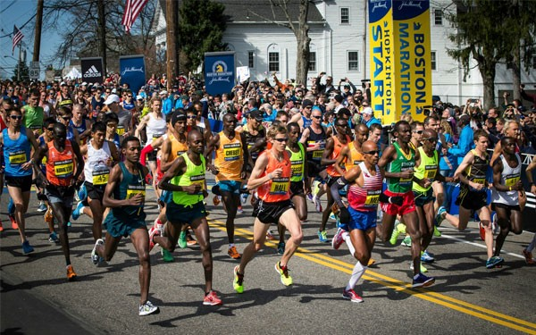
Motivation
Give insights to Boston Marathon, one of the world’s best - known road racing events.
Decode the secrets of runners, age, genders, pace, and states where runners come from.

Slide 3
Datasets
The data is from the years 2015. 2016, 2017 . It contains the name, age, gender, country, city and state (where available), times at 9 different stages of the race, expected time, finish time and pace, overall place, gender place and division place.
GPS data containing altitudes of the points on the course

Slide 4
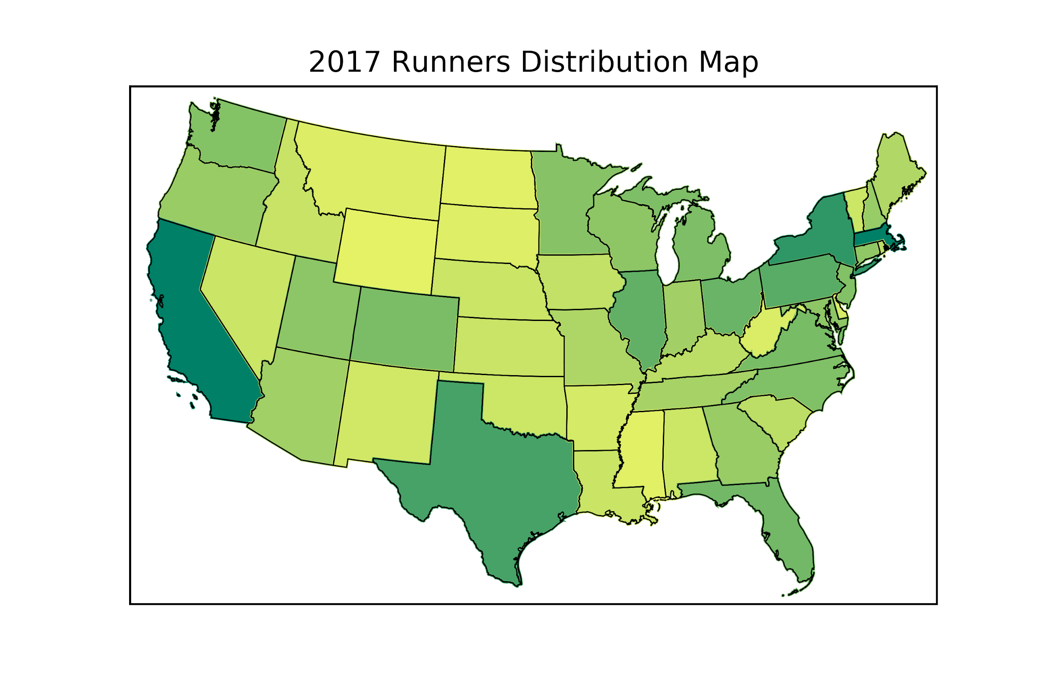
US Runners Distribution Map
Over 98% of runners are from US
The majority of runners are from California, Texas and Massachusetts
The numbers of runners are related to the economic level and population of the state
Notes:
Can mention that the United States is excluded

Slide 5
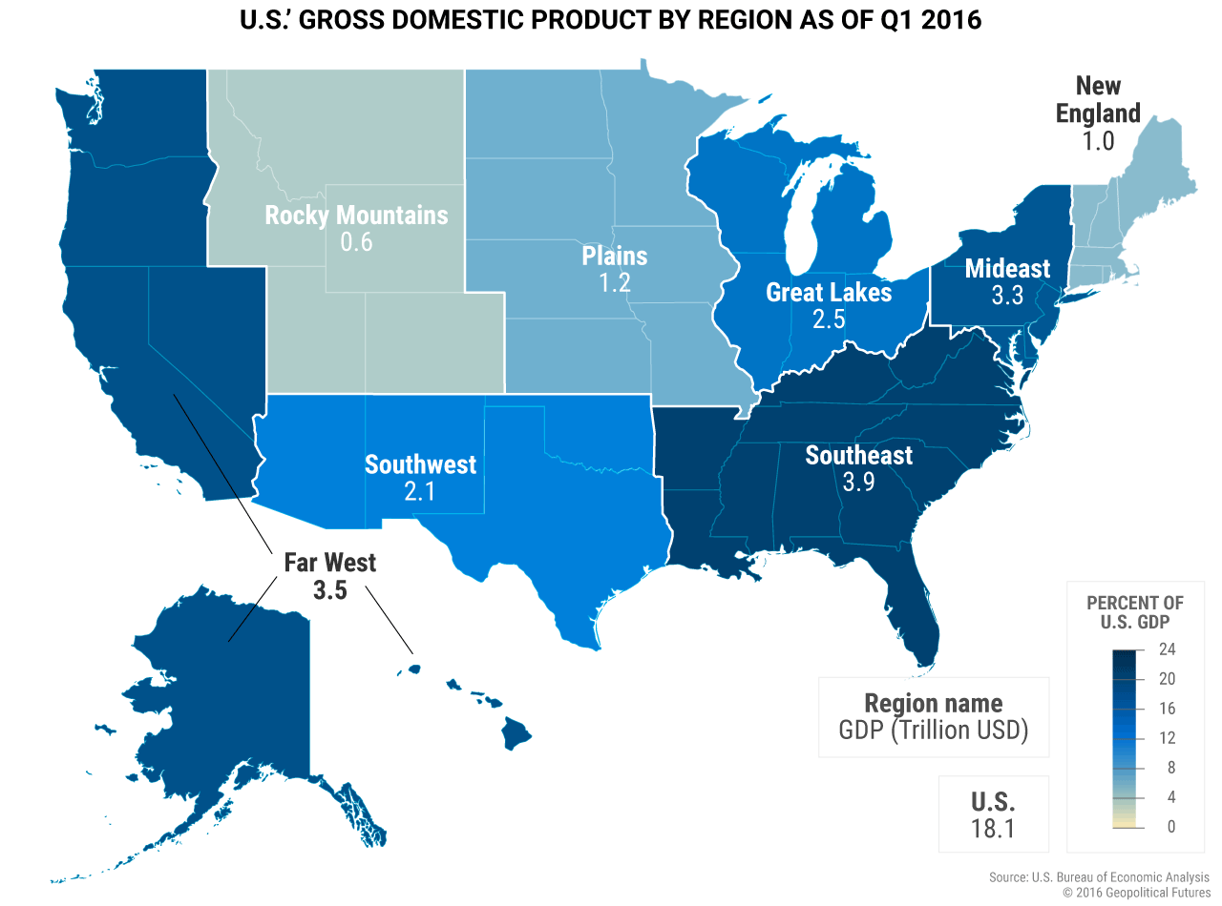
US GDP Map
The GDP Map and the map of numbers of runners reflects the relation between economy level and participation for sports
Resource: https://geopoliticalfutures.com/a-tale-of-two-economies-russia-and-the-us/

Slide 6
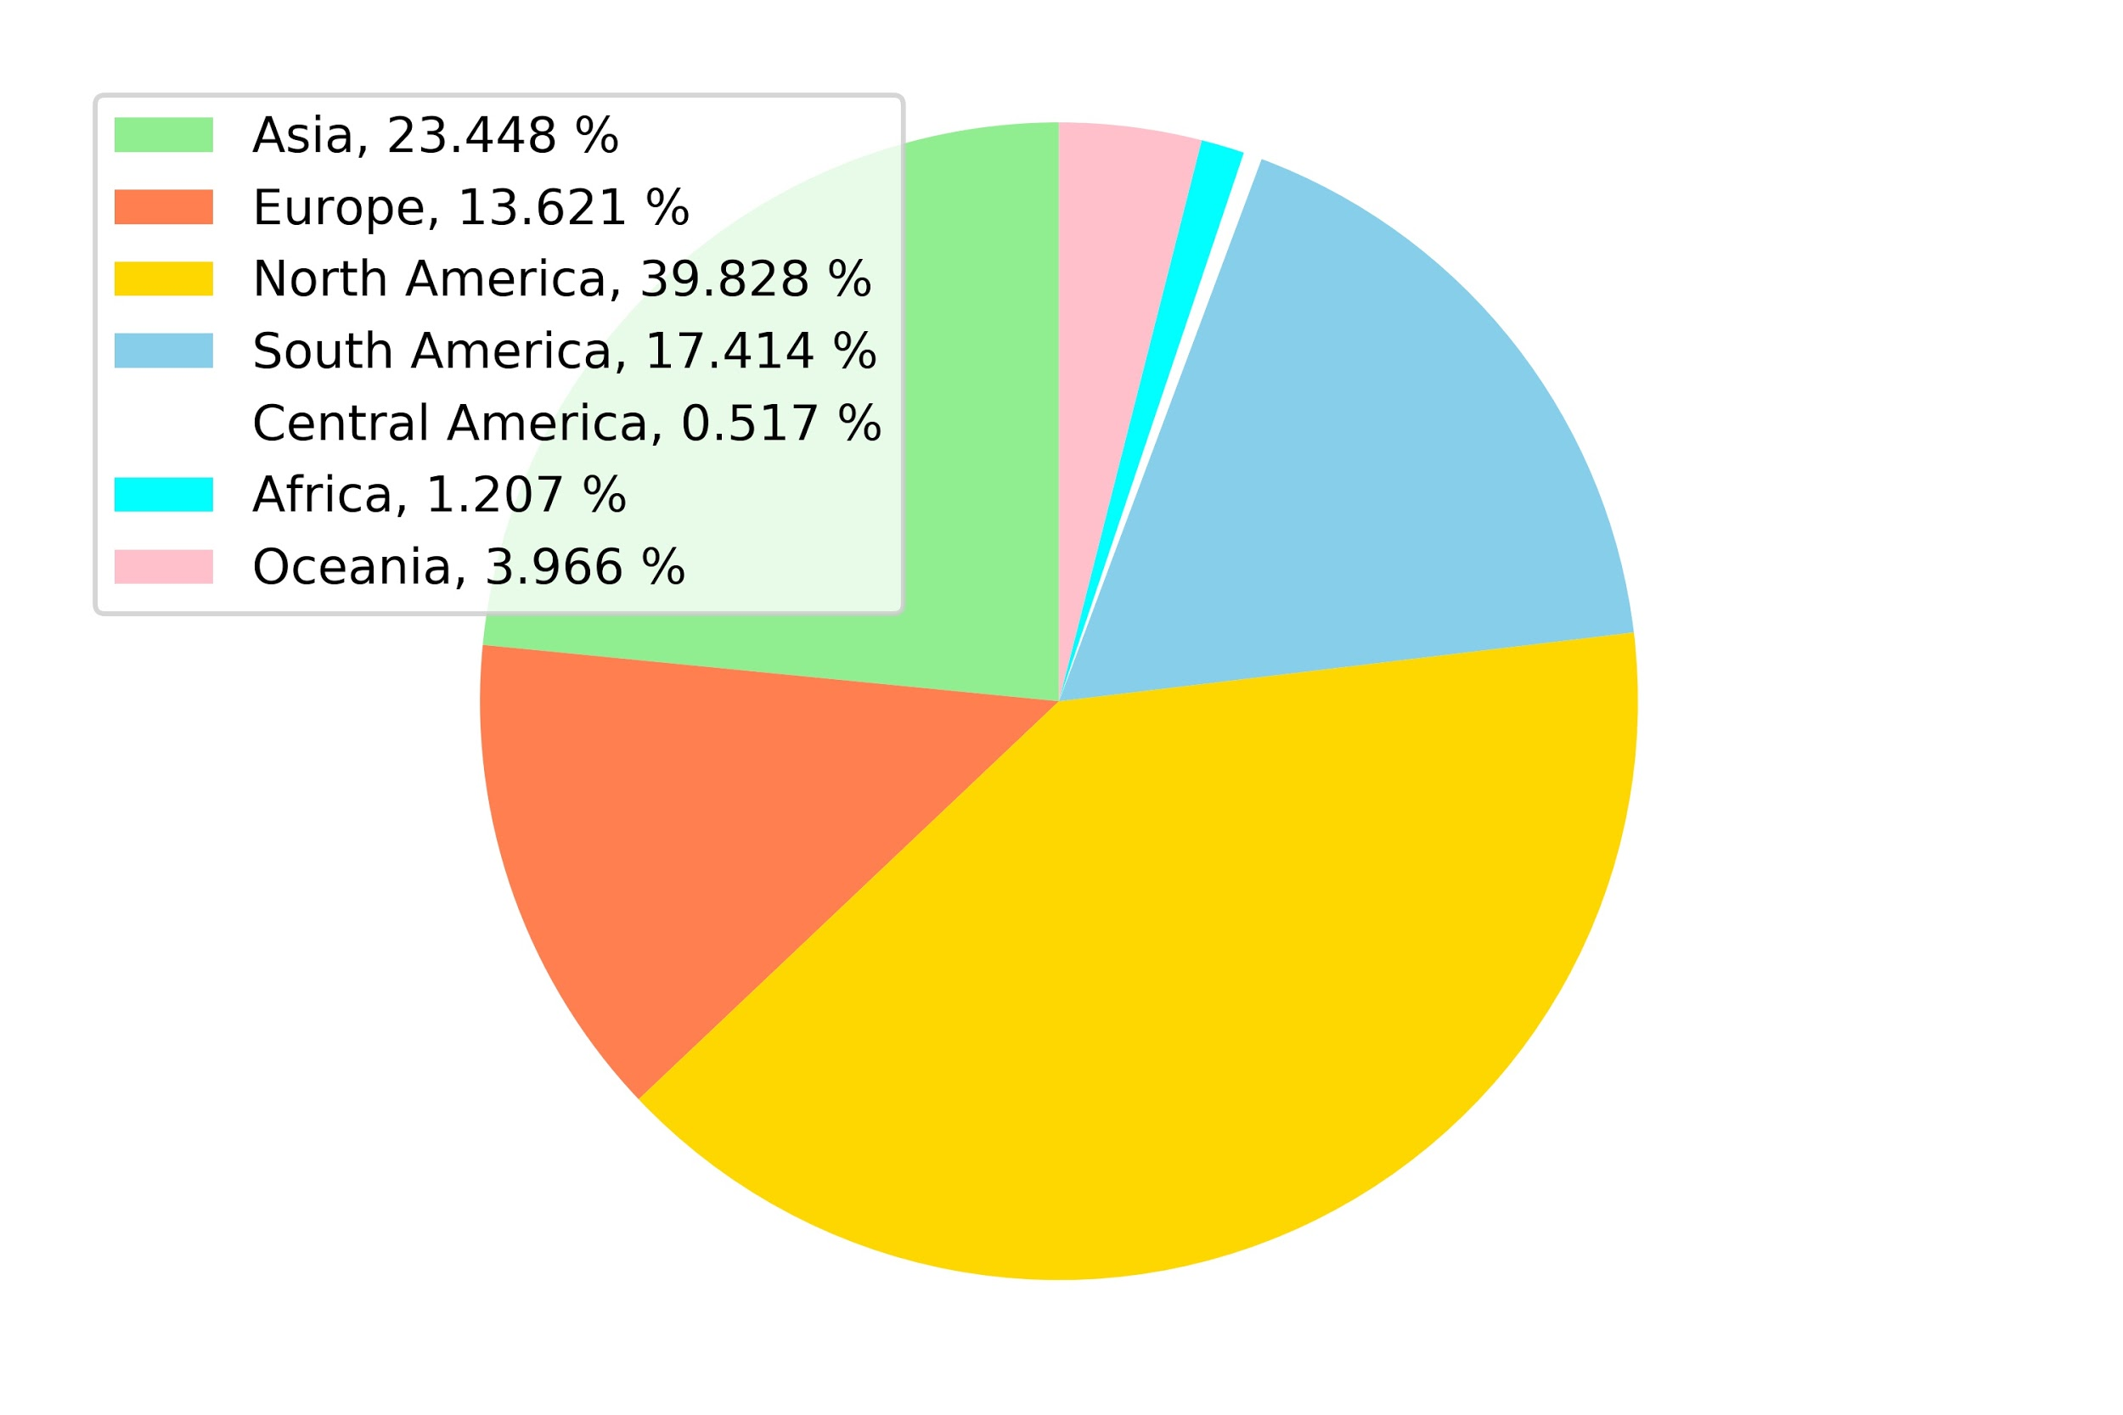
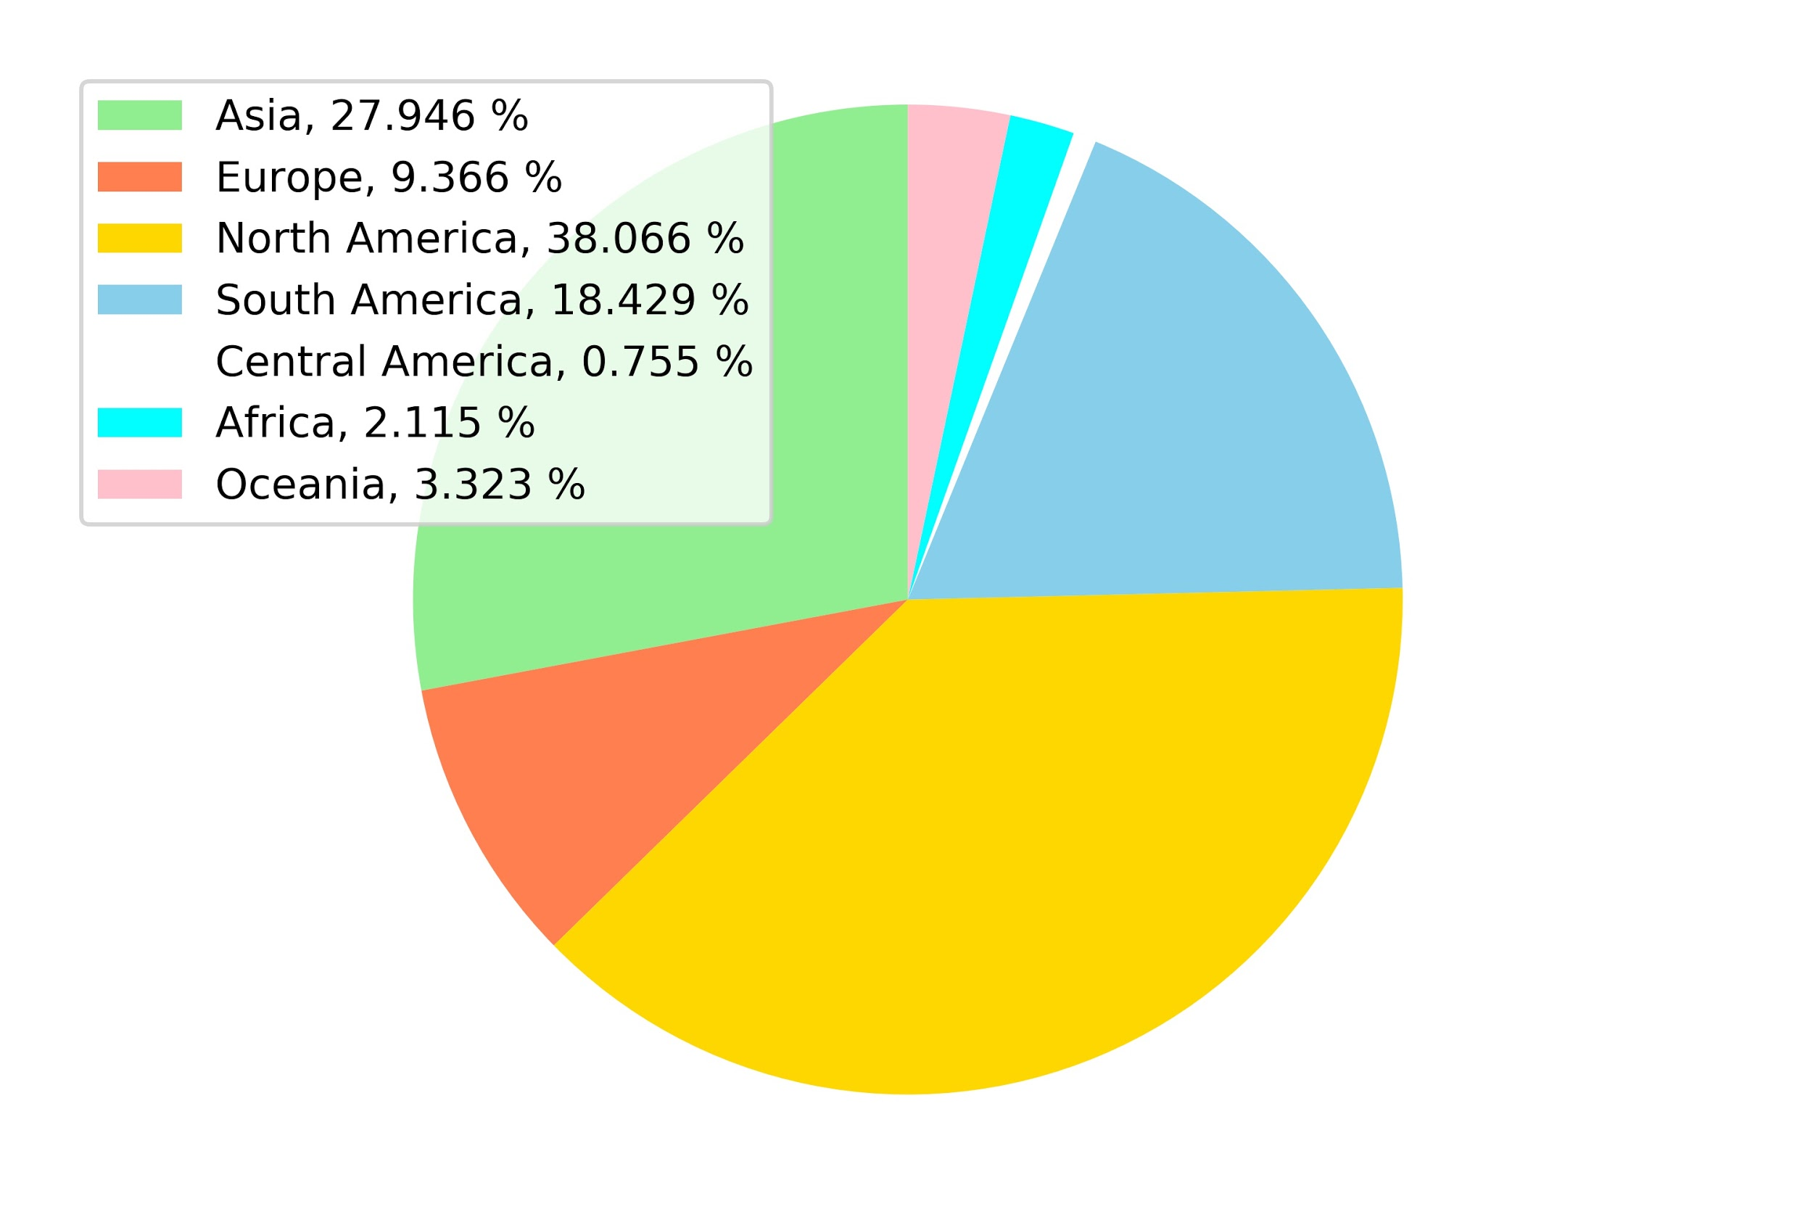
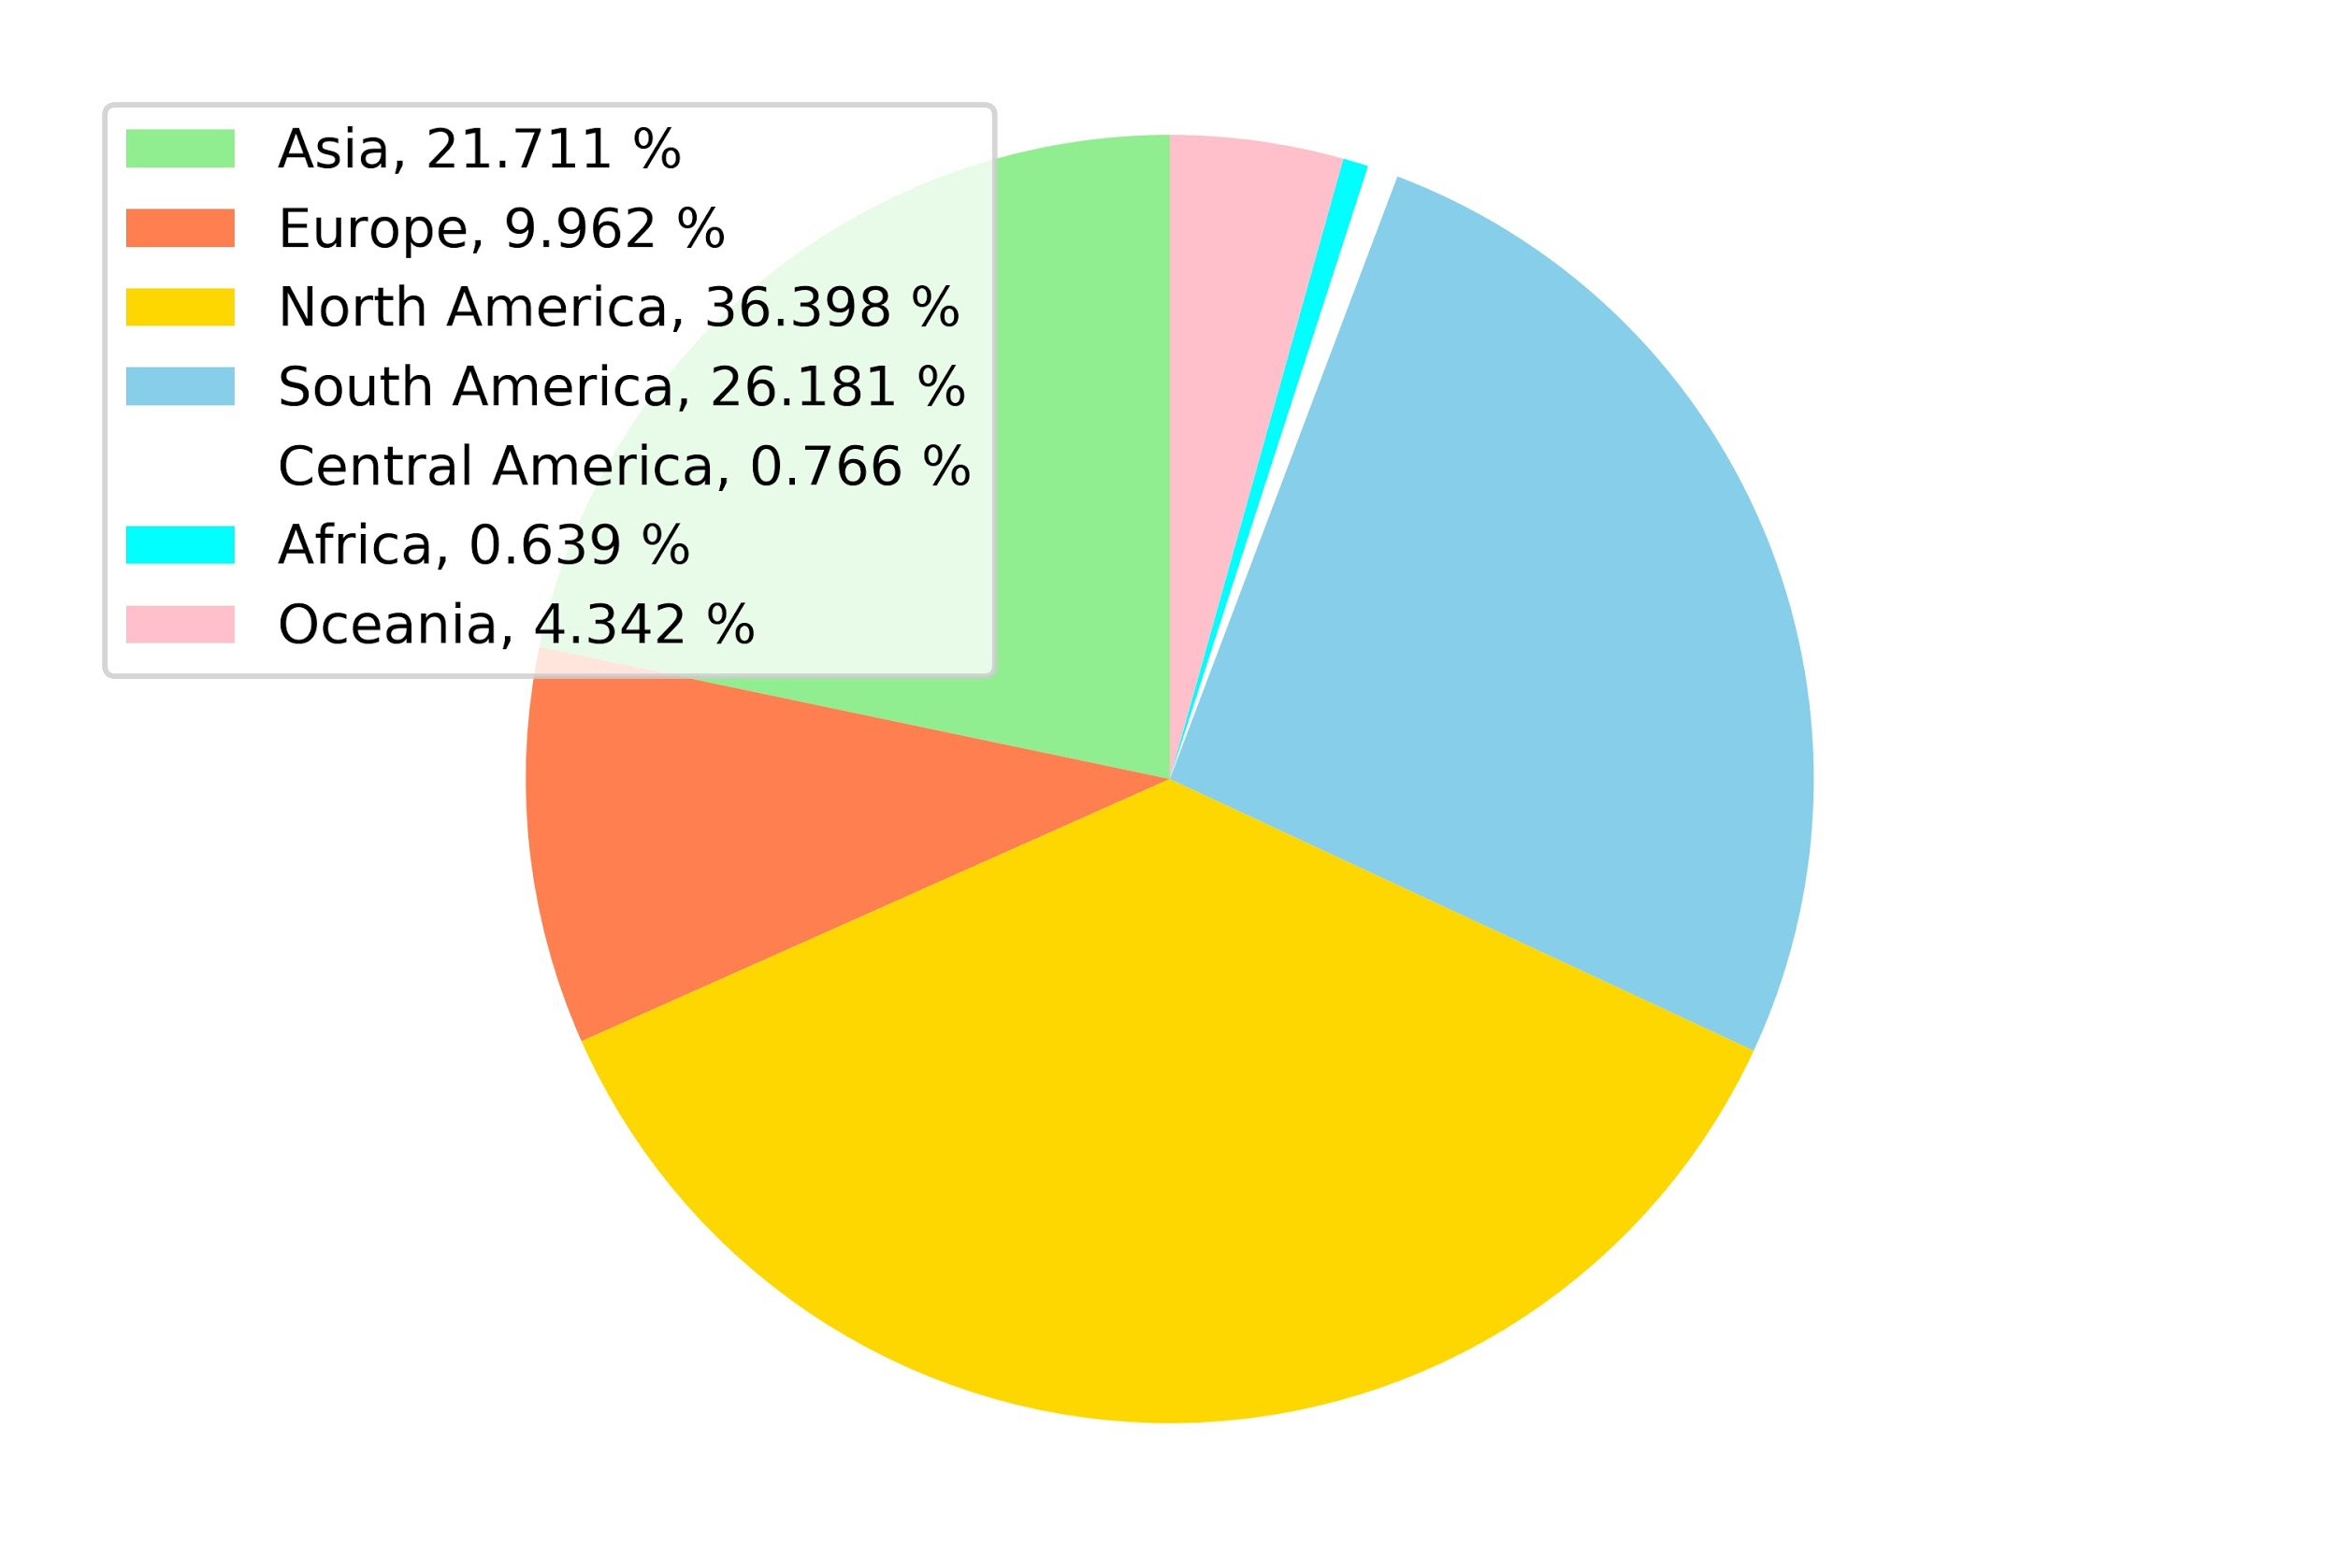
Year comparison of runners of continents
(US excluded)
2015
2016
2017

Slide 7
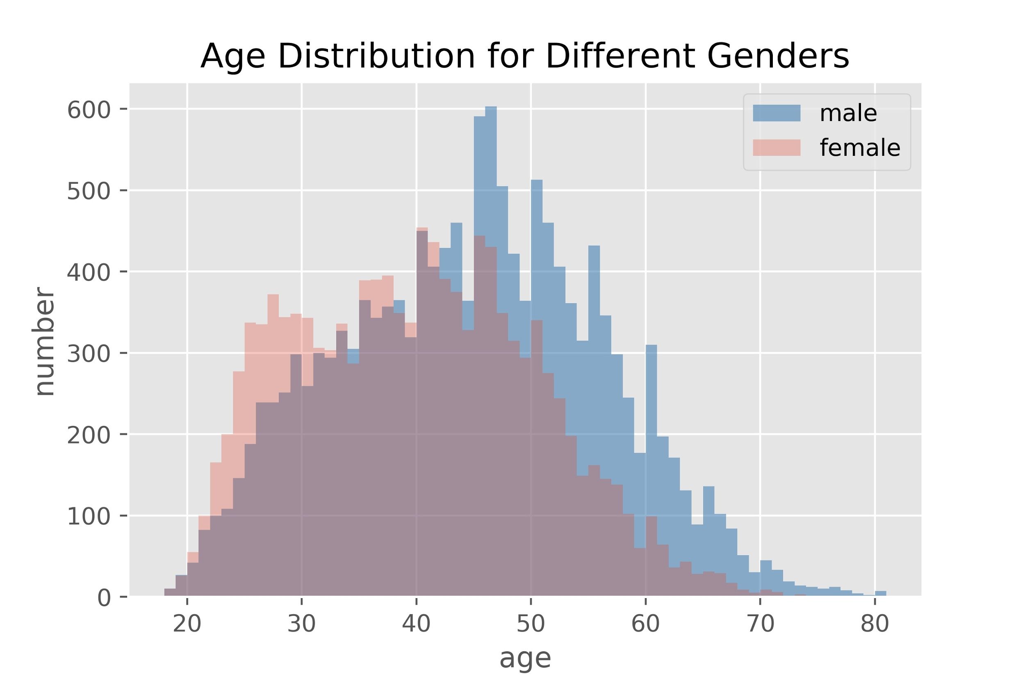
Runner Demographics
There are more male runners than female runners in the dataset.
Most of their ages are between 40 to 50.
It could be due to the fact that young people are inclined to team sports but not individual sports.
Notes:
There are more male runners than female runners in the dataset. Also, we might think that younger people might have more motivation to attend the marathon, but obviously from this plot, most of the participants are in their 40 to 50, and it could be the fact that young people are more into team sports but not individual sports.

Slide 8
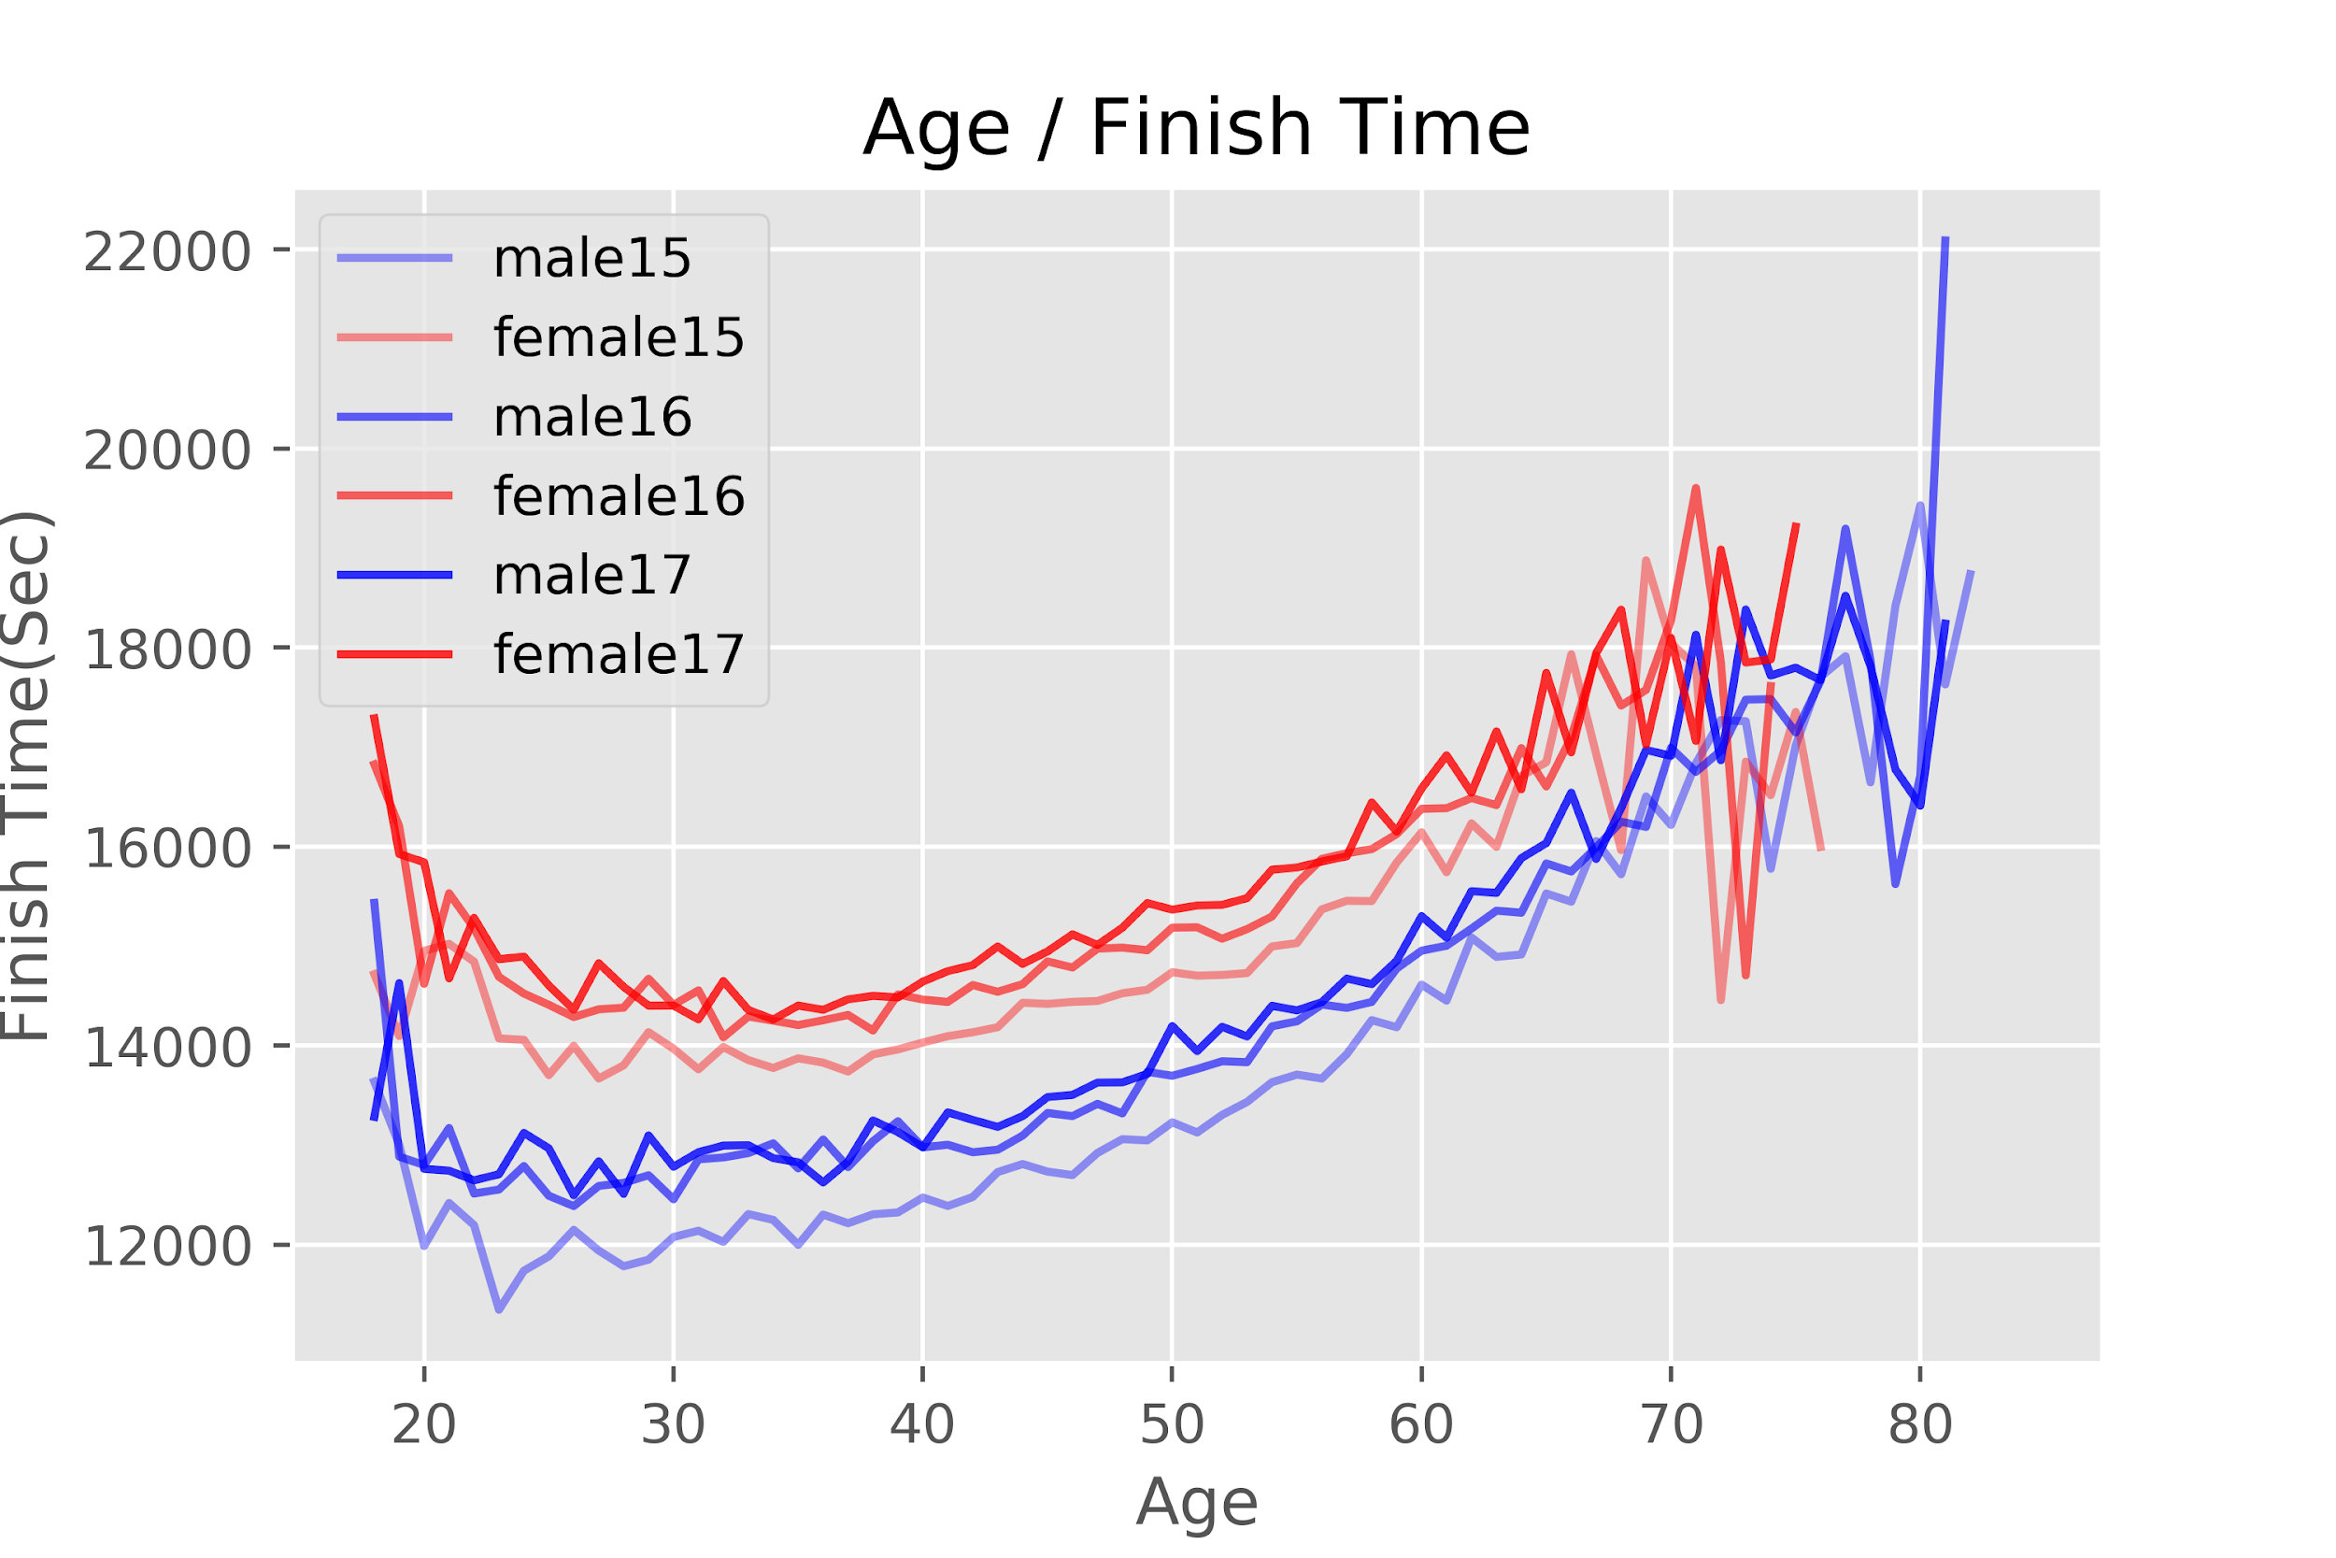
Finish Time
As we can see from this plot, we notice that the shortest average of the finish time occurred in 30 years old.
Also, we found that even though women spent more time than men, there is a reverse between 70.
Notes:
Also, normally we would assume that younger people have more energy or power to have a better performance. However, when we see the plot, we can notice that it is like a curve. The best performance is between 20-30 but not under 20. It might be because that marathon is a more experienced-based sports, when you gain more experiences, you can have a better performance. Also, we found that there is a reverse for female runners between 70-75. But it might be due to there are no enough data for age from 70-75.

Slide 9
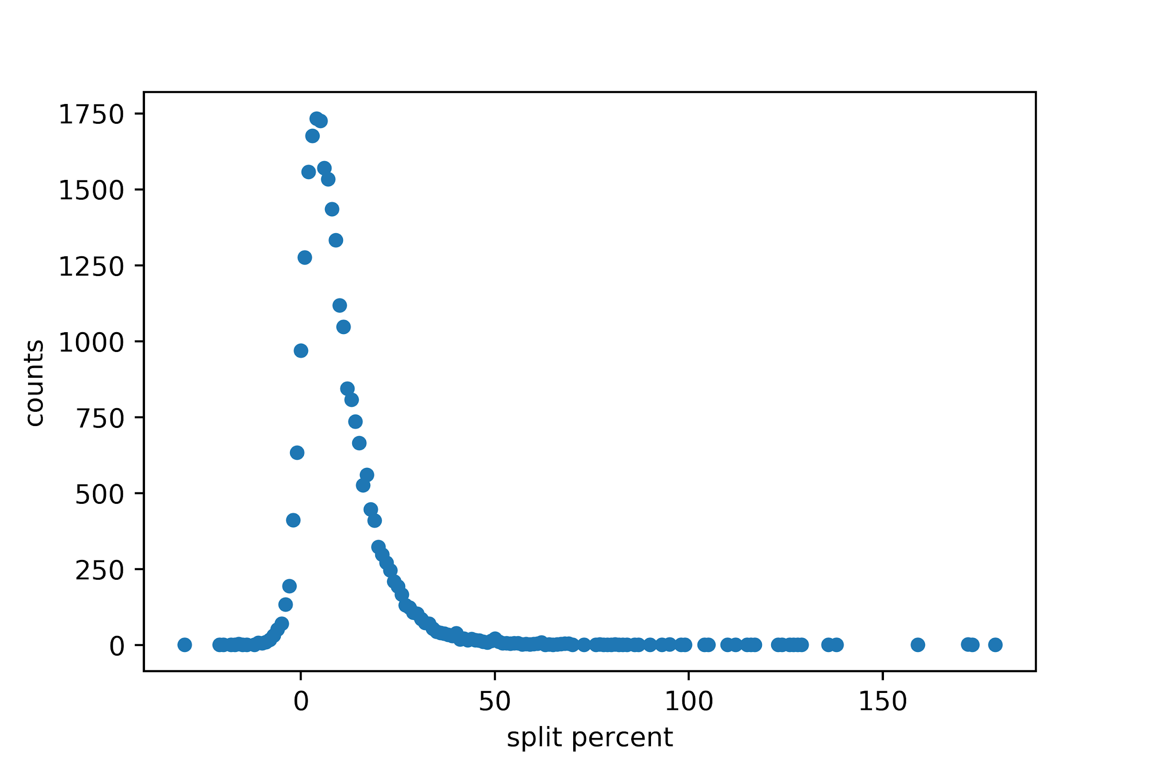
Negative Split
Negative split is a racing strategy where you run the second half faster than the first half.
Not everyone can achieve a negative split. In fact only 3% of runners ran a negative split in 2017.

Slide 10
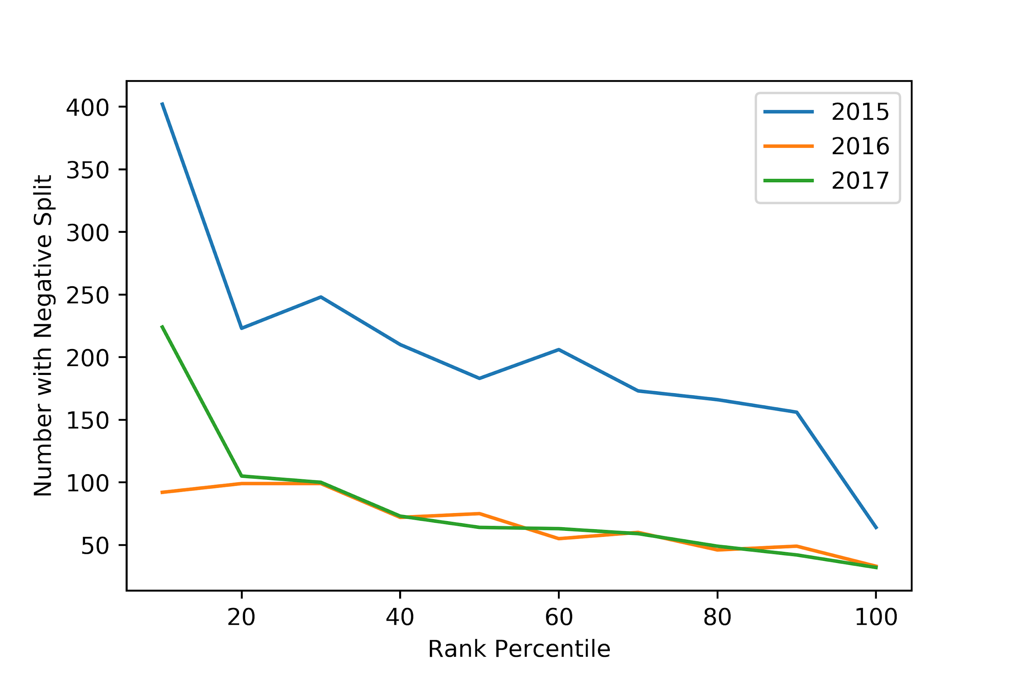
Negative Split
Elite athletes run a negative split more often than regular runners.
More runners achieved negative splits in 2015, may be due to weather.
Year | Temperature | Sky
2015 | 46-46 | Overcast
2016 | 71-61 | Clear
2017 | 70-73 | Clear

Slide 11
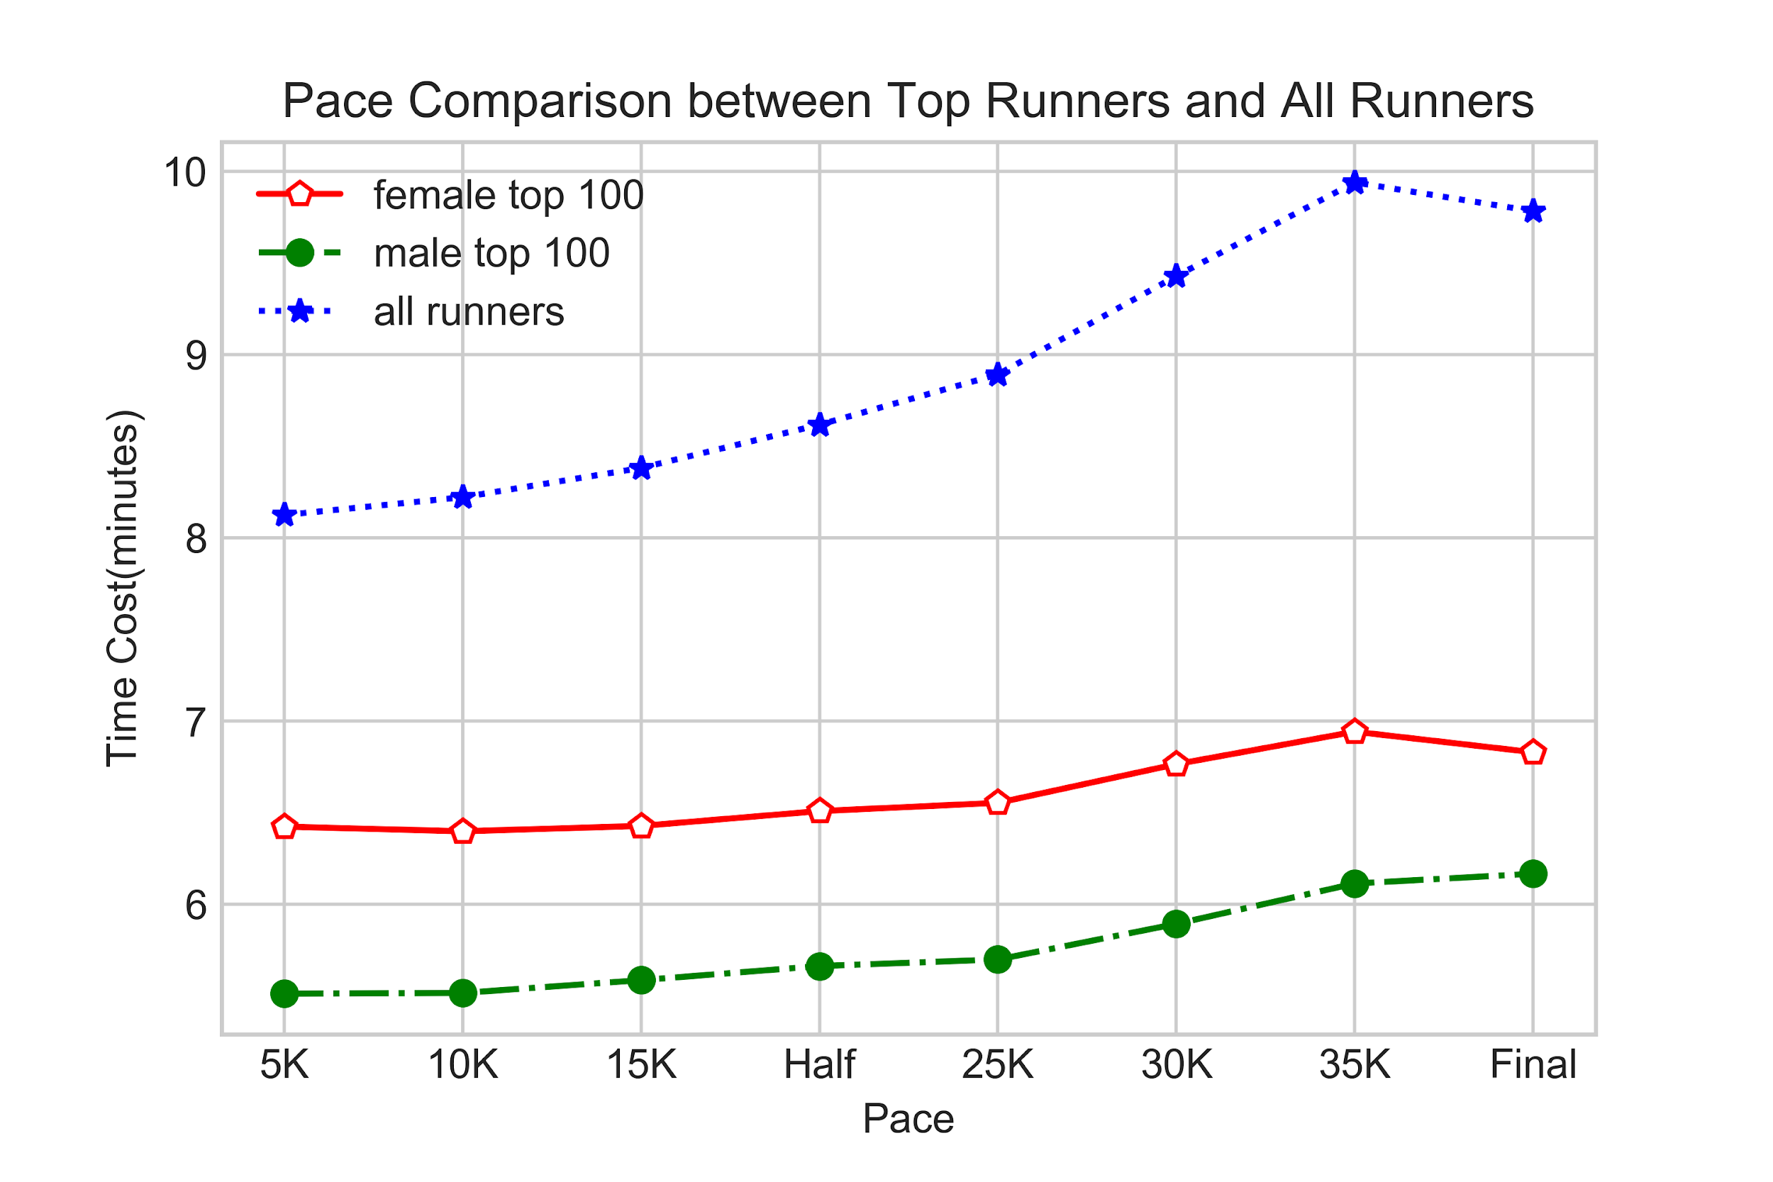
Pace Comparison
The pace variation of top runners is smaller while the pace changes violently among all runners.
Top runners’ performance is more steady than all runners.

Slide 12
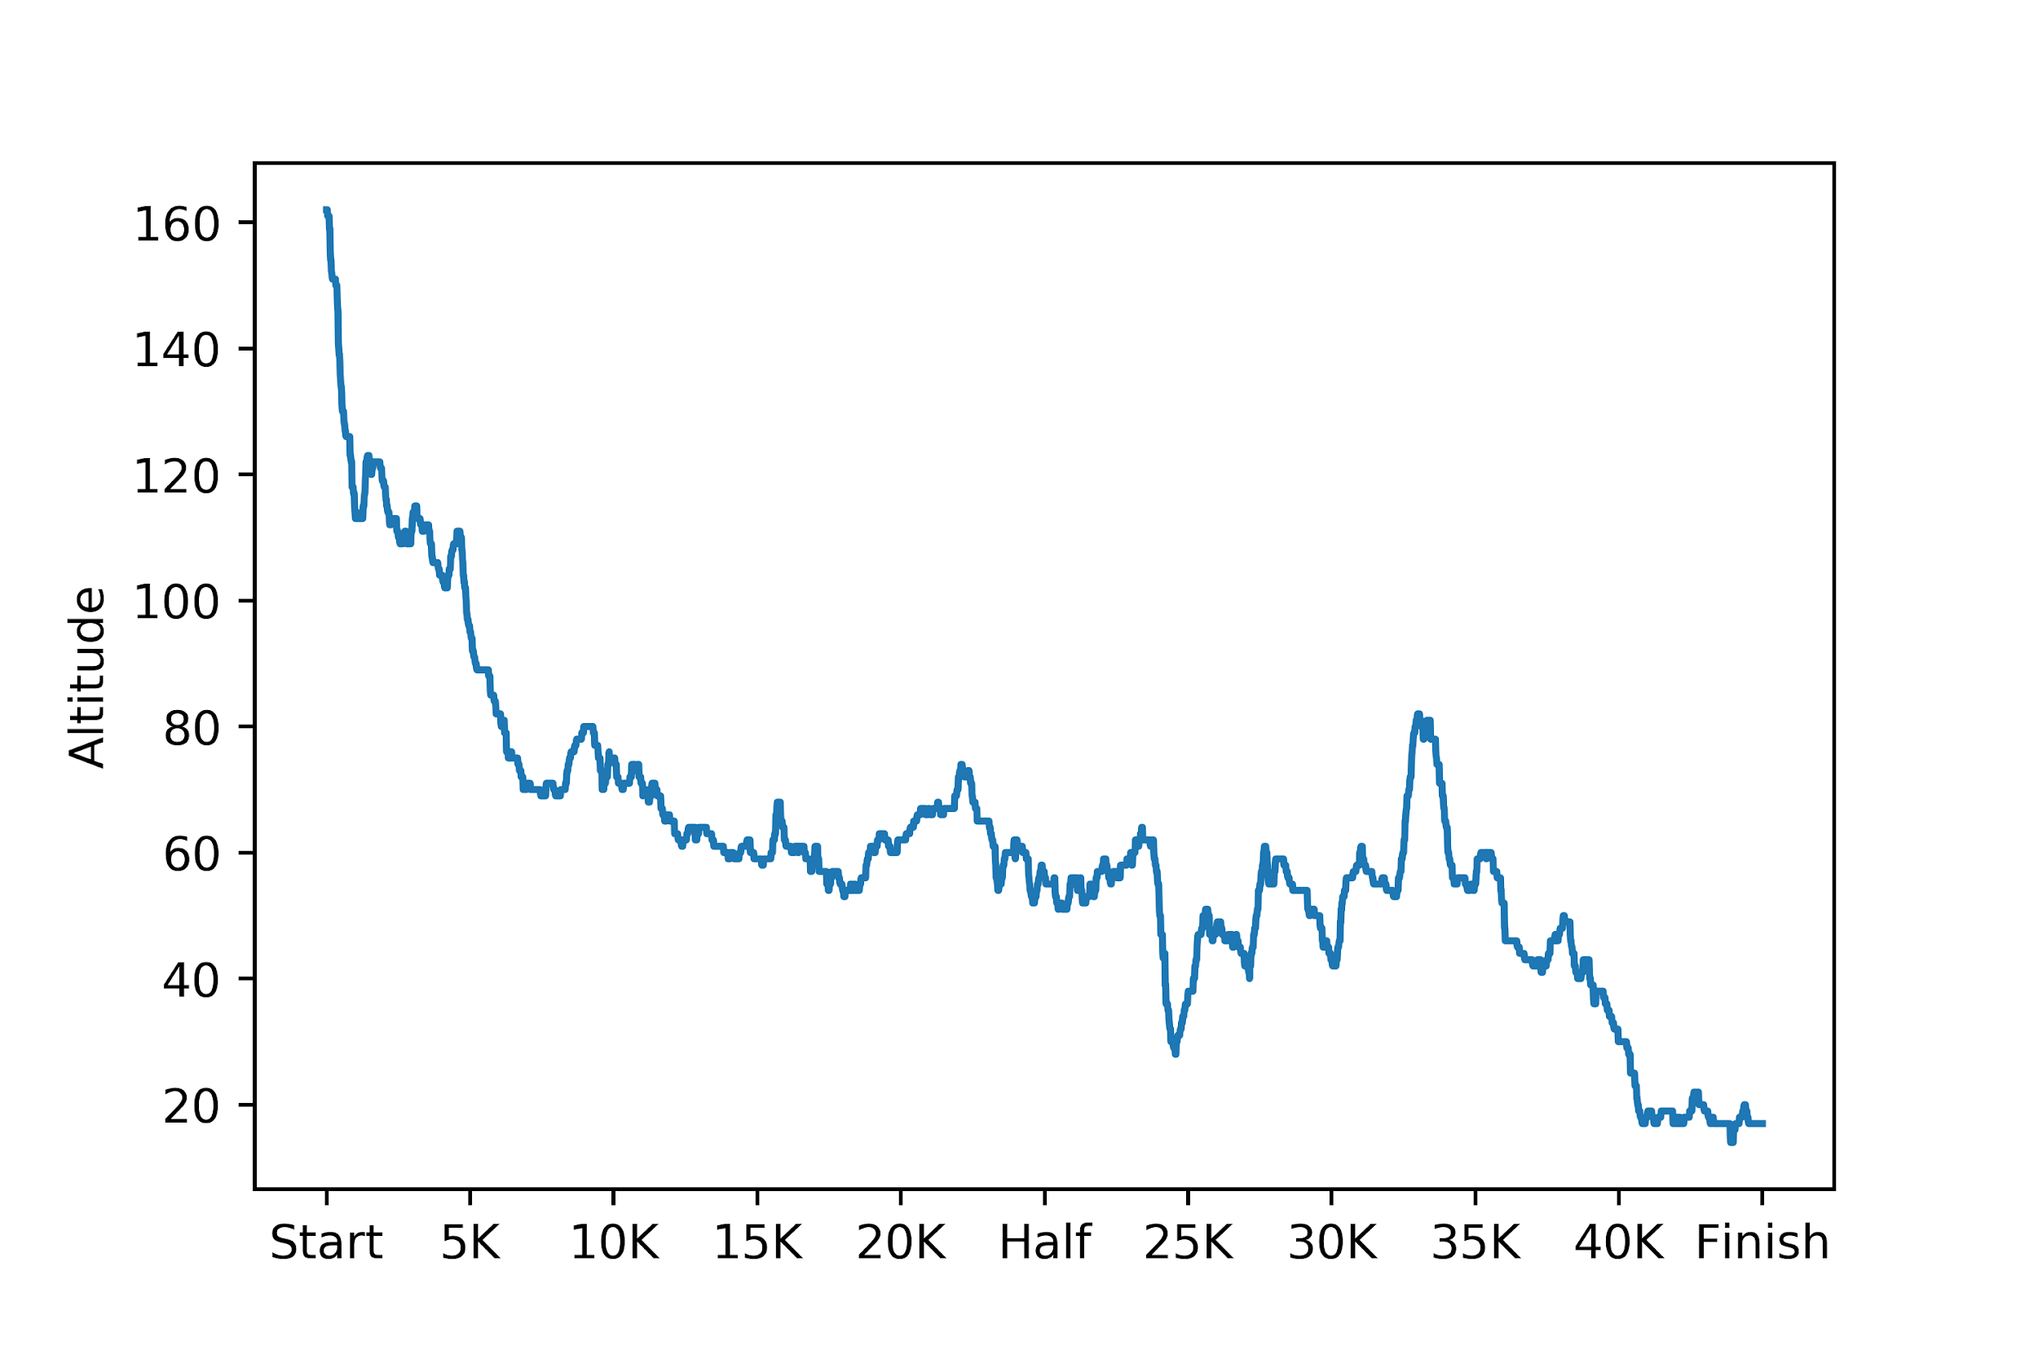
Boston Marathon Route
We can see the route goes downhill till 25K.
Around 32K there is a hill known as “HeartBreak Hill”

Slide 13
Conclusions
Geographical factor: The majority of runners are from North America, specifically from Massachusetts, California and Texas. But Boston Marathon is becoming more international.
Age factor: The participation peak is between ages 40-50, and the best performance is between ages 20-30. It can be due to experience and preference for individual sports.
Strategic factor: Negative Splits is used as a strategy by runners but can be achieved only by few elite.
Strategic factor: Elite runners have much more steady paces, which means runners can improve their performance by controlling their paces

Slide 14
Thank You

